Slide 1


Soil Analysis and Ground Evaluation
Eithan Capella, Emmanuel González, Bryan Vega

Slide 2
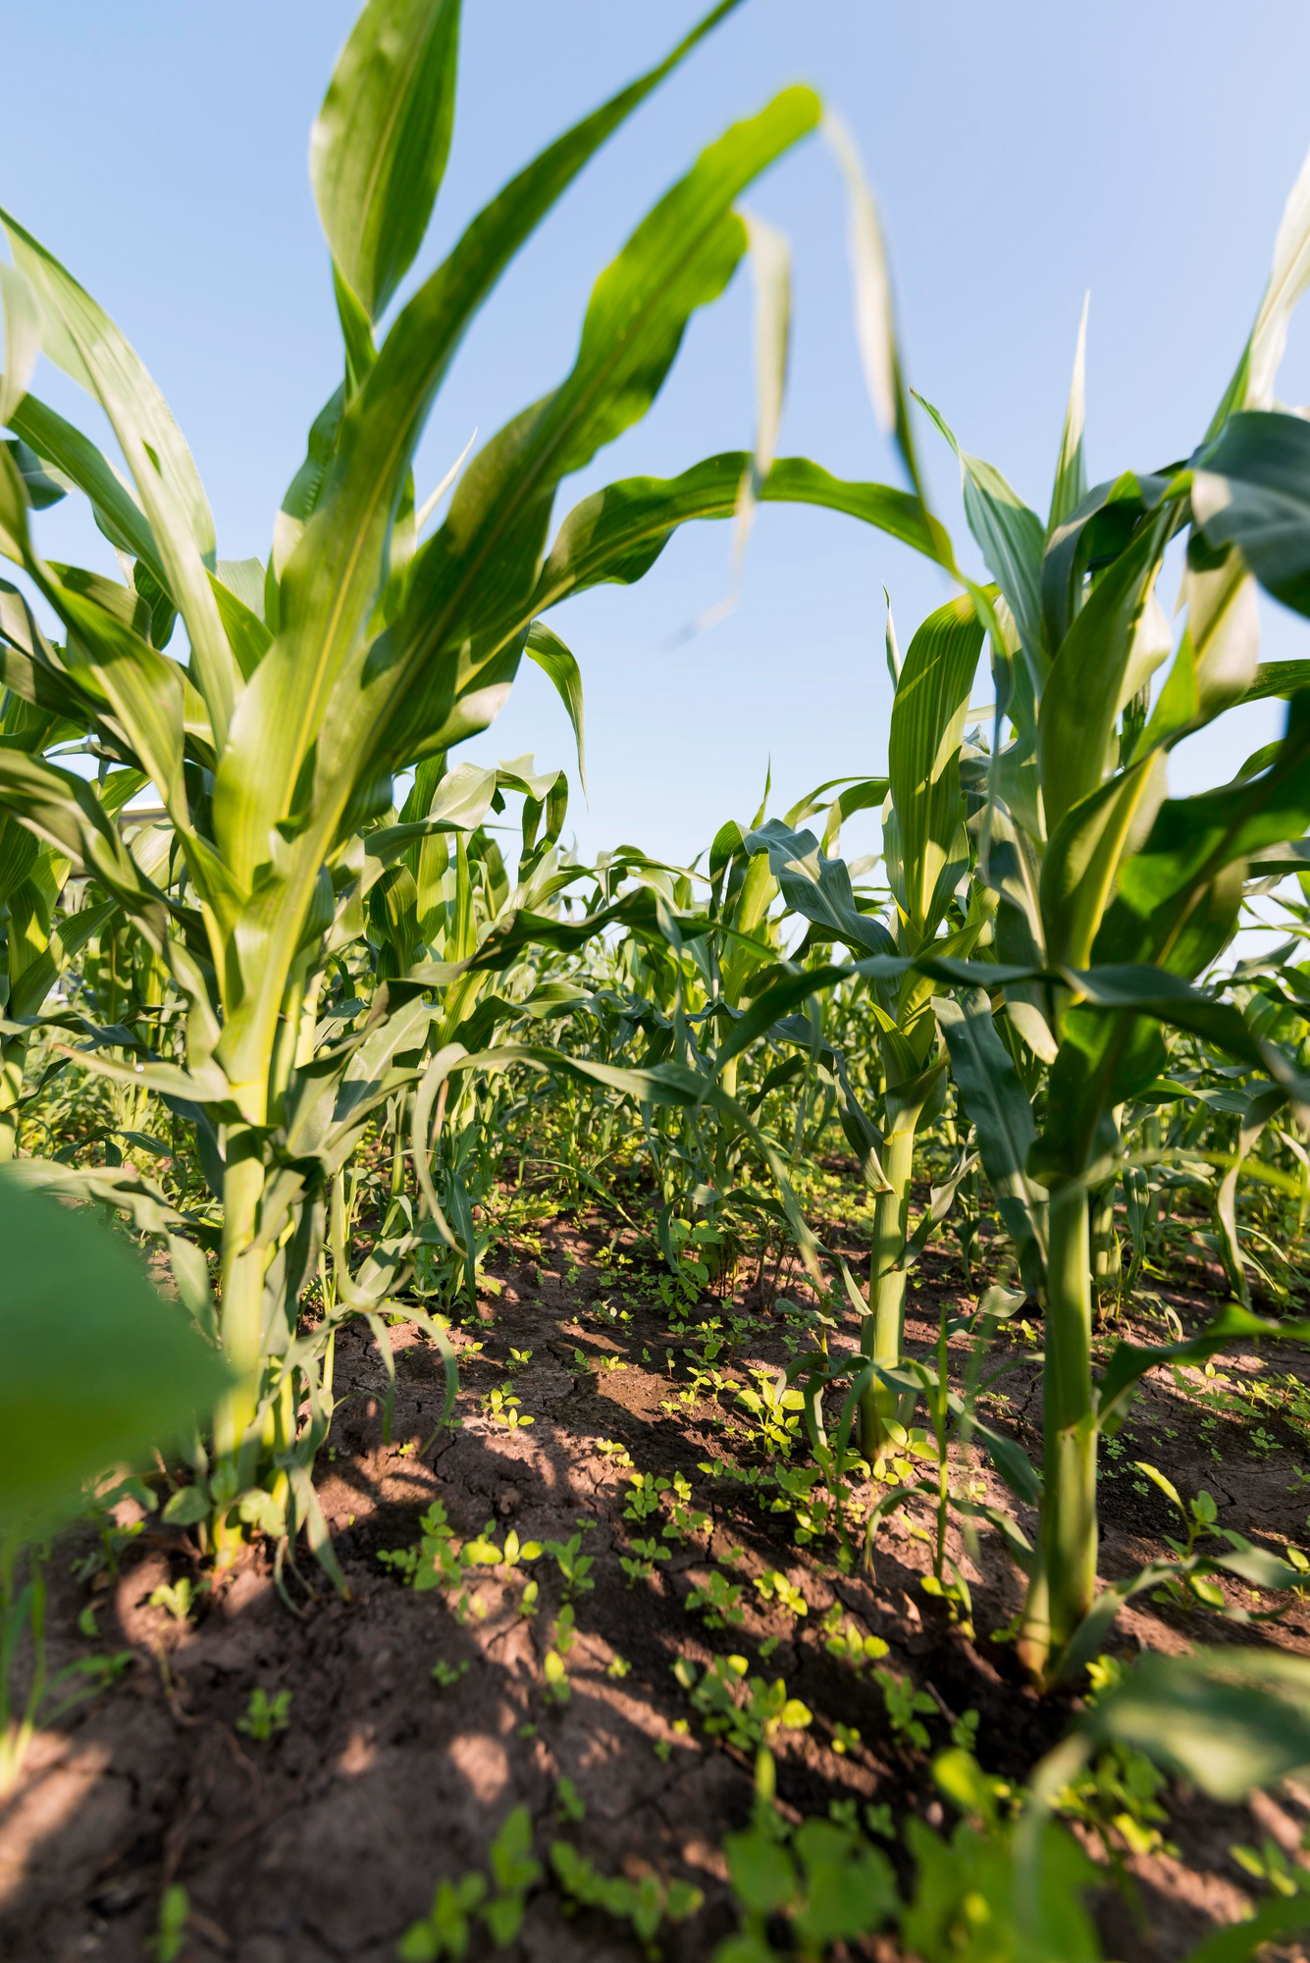

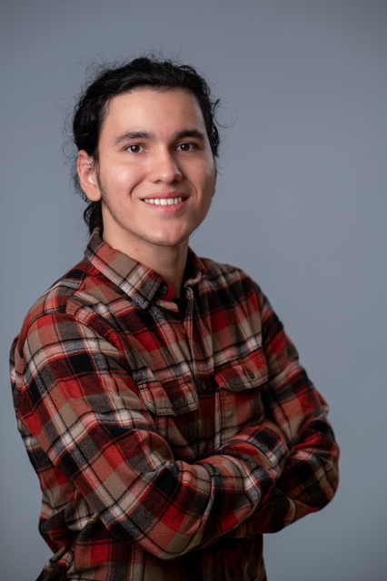
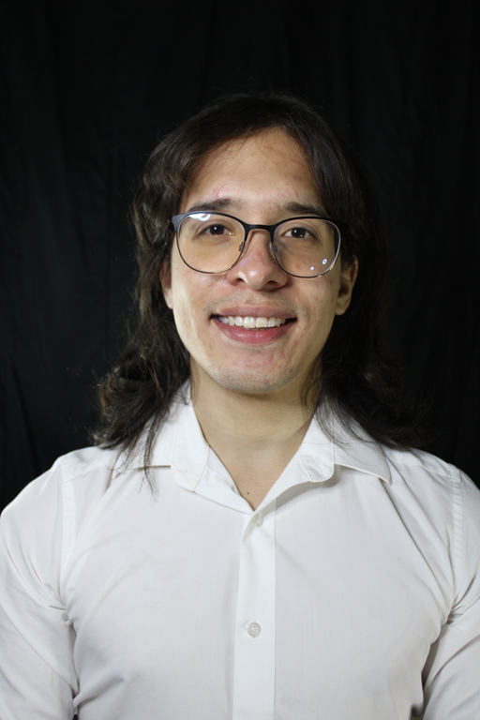

S.A.G.E
Team Members
Eithan Capella
Emmanuel J. González Morales
Bryan D. Vega González

Slide 3
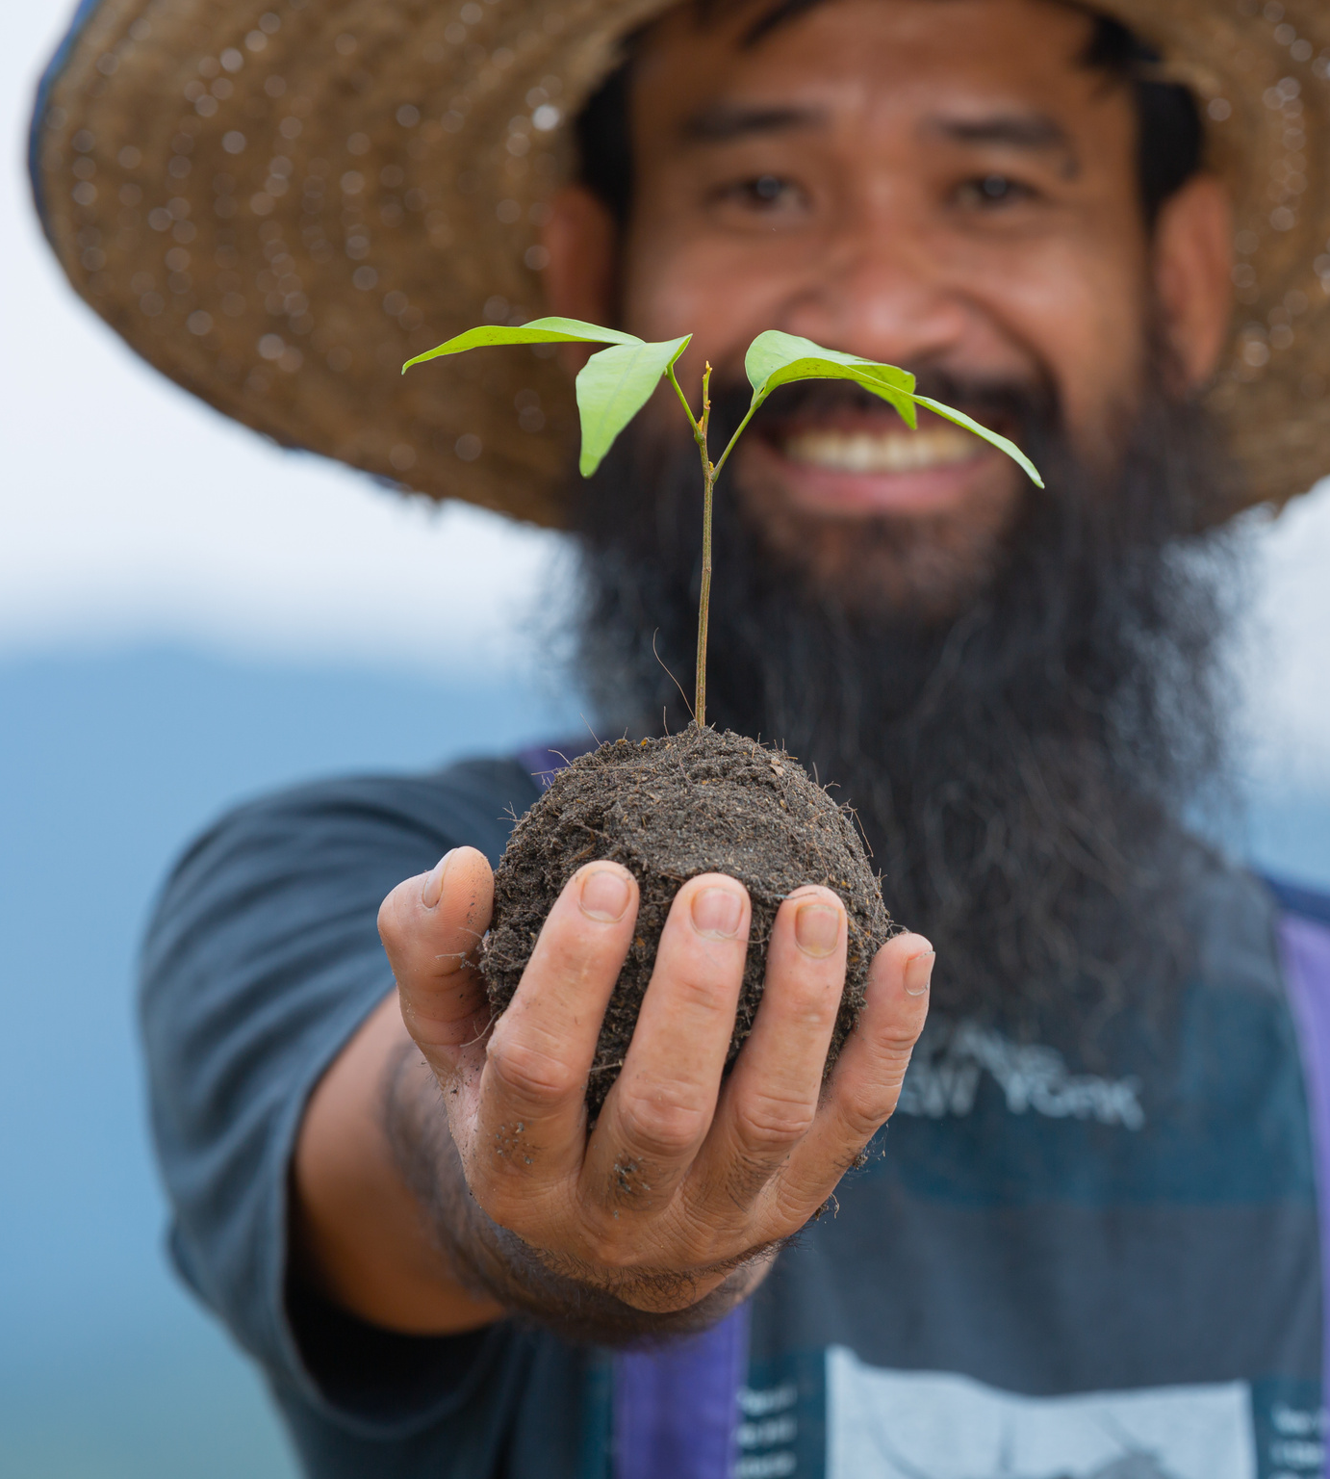
S.A.G.E
Why Soil Health Matters
Healthy soil is the foundation of profitable, sustainable agriculture
Contamination (heavy metals, excess fertilizer, erosion) reduces productivity
Traditional lab tests are expensive and take days , or even weeks, to process
Climate variability makes farmers’ decisions prone to error

Slide 4
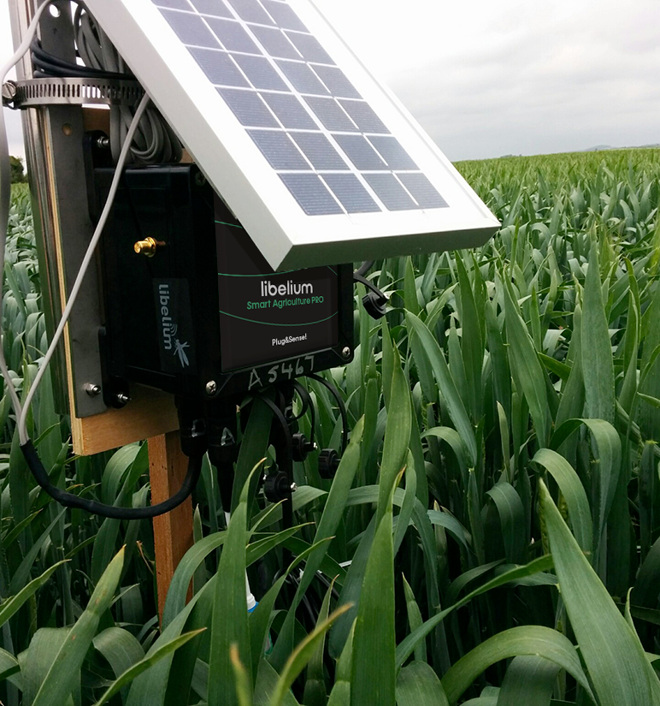
S.A.G.E
Market Gap
High-end IoT solutions exist, but are extremely inaccessible
Low-cost DIY kits are economically accessible, yet lack accuracy, ruggedness, or long-term data management
OPPORTUNITY
Equip farmers with an affordable, yet reliable device that monitors soil in real time and presents it to them in an interpretable way

Slide 5
S.A.G.E
Proposed Solution
Specific Objectives
S.A.G.E. seeks to give small- and medium-scale farmers the same actionable insight that large operations obtain from expensive laboratory programs, but without the cost or delay.
Provide immediate, on-site readings of moisture, temperature, pH, and NPK so problems surface before yields drop.
Cut reliance on outside labs by matching agronomic accuracy thresholds and shrinking turnaround from weeks to minutes.
Enable data-driven fertilization and irrigation, lowering costs, and reducing nutrient runoff.
Democratize precision agriculture with hardware that is low-cost, self-contained, and simple enough for resource-limited farms

Slide 6
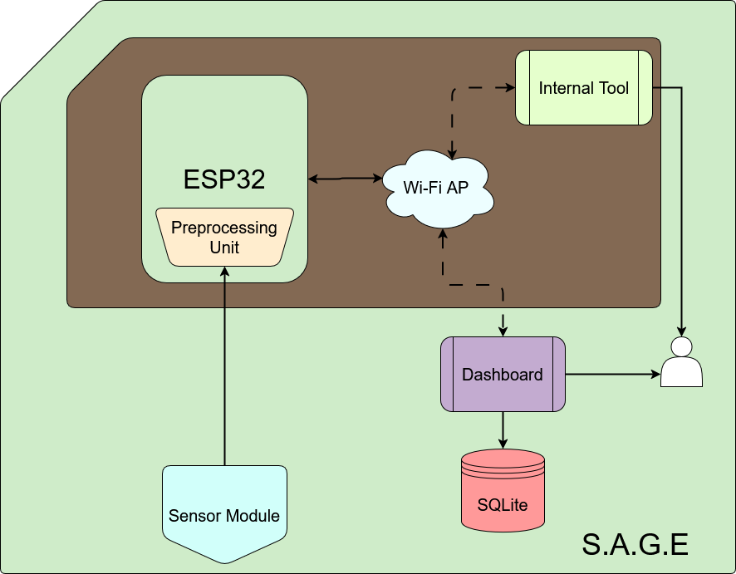
S.A.G.E
Methodology - System Overview
ESP32
A microcontroller that powers the whole system
Measurement Instruments
A bundle of sensors—soil-moisture, soil-temperature, humidity, temperature, pH, and NPK nutrients—that feed real-time soil data straight into the ESP32
Internal Tool
A web service running on the ESP32’s hotspot. It lets any browser start/stop logging, but it also exposes the data over simple API routes, acting as the bridge that delivers data to the mobile app.
Mobile Application
A cross-platform app that pulls logs from one or many ESP32 units, and stores them locally.

Slide 7
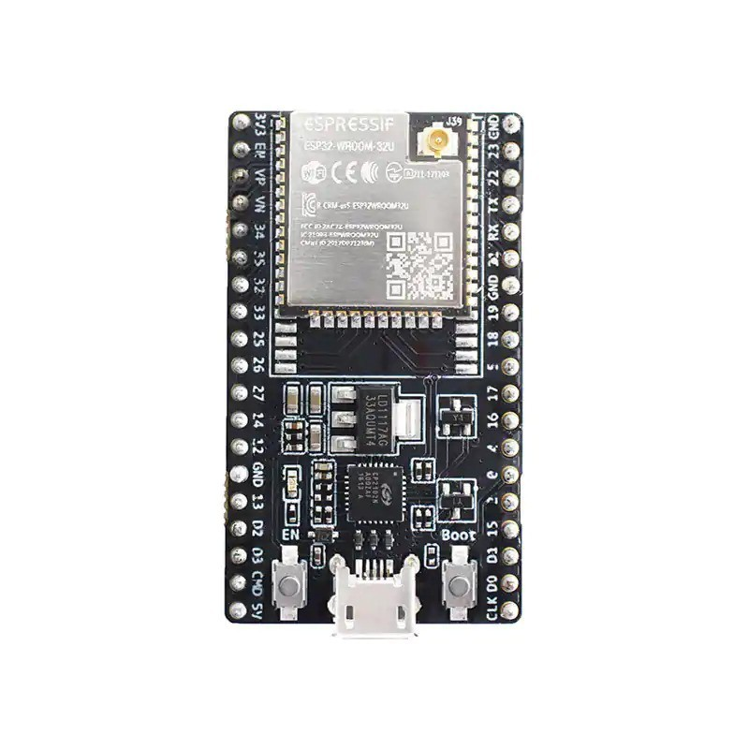
S.A.G.E
What the ESP32 does
Collect the Readings
Cleans the data
01
02
Every few minutes the ESP32 wakes each sensor, grabs a fresh value, and stamps the exact time so trends make sense later.
It averages away any sudden spikes and keeps the numbers within realistic limits, ensuring the farmer sees reliable information instead of raw noise
Stores everything locally
Hosts the Internal Tool
03
04
The polished readings are written line-by-line into simple CSV files kept in SPIFFS—the ESP32’s built-in flash file system.
It averages away any sudden spikes and keeps the numbers within realistic limits, ensuring the farmer sees reliable information instead of raw noise

Slide 8
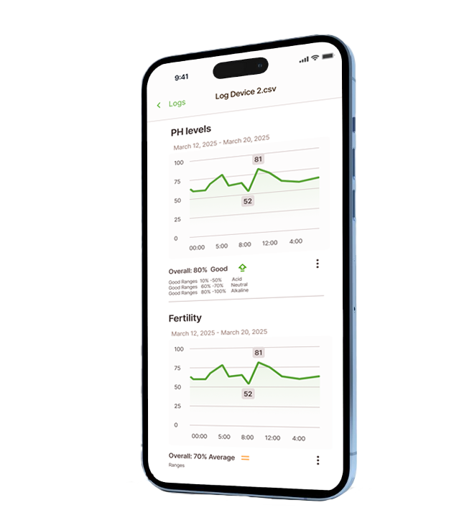
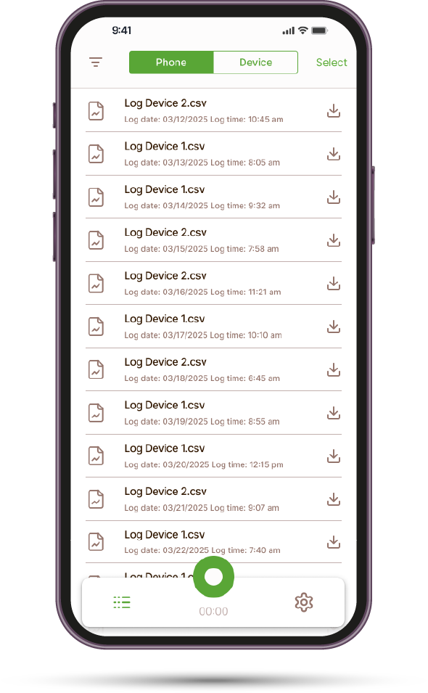
S.A.G.E
Mobile App
Built with React Native and the lightweight Tamagui UI library, giving a consistent interface on both Android and iOS.
01
Connects directly to the ESP32’s Wi-Fi hotspot and issues simple REST commands—start, stop, or download—so it works even without cell service.
02
Parses each CSV log on arrival and stores it in an on-device SQLite database, keeping data available offline.
03
Tags every record with its source ESP32, allowing one phone to manage multiple units and maintain months of soil history.
04

Slide 9
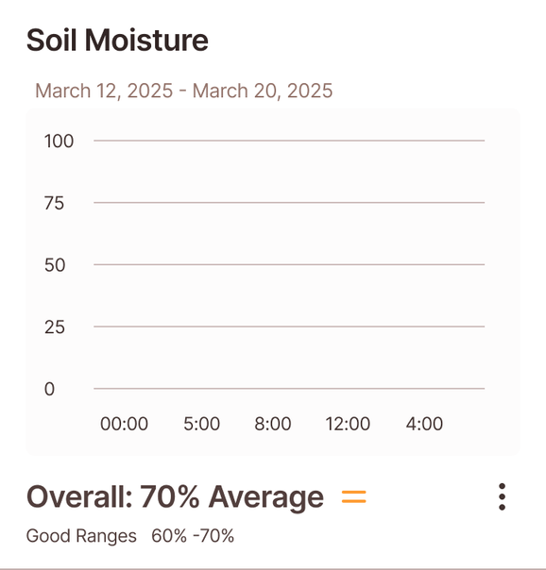
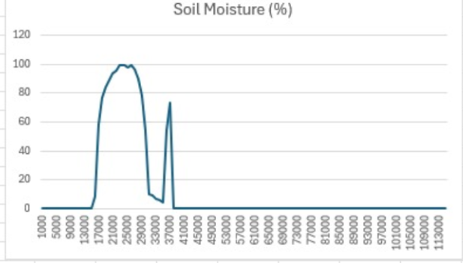
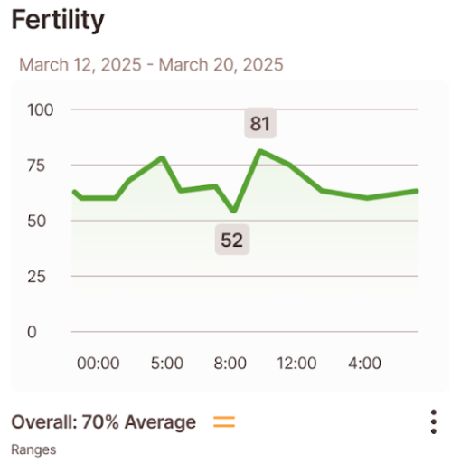
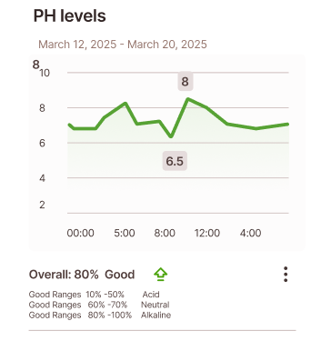
S.A.G.E
Measuring Systems
Each chart layers time on the horizontal axis with any sensor the user chooses on the vertical axis, making it easy to notice a moisture dip, a pH swing, or a gradual nutrient decline at a glance.
Once a log has been pulled from the ESP32, the mobile app turns the raw CSV rows into clear, touch-friendly charts rendered on the phone itself.
You can compare yesterday’s soil profile with last month’s, helping farmers make decisions based on the data.

Slide 10
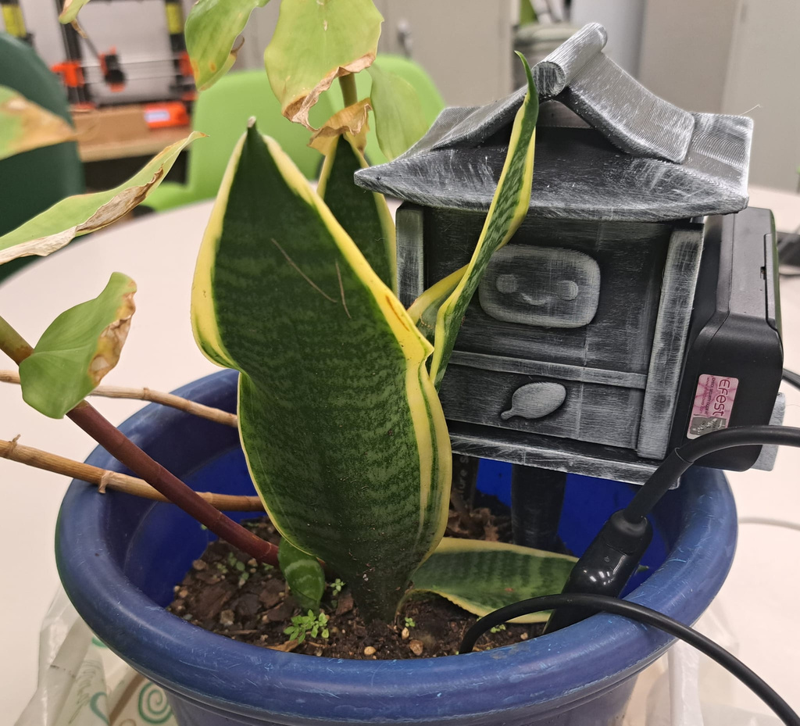
S.A.G.E
Accurate, On-Site Readings
All five core measurements instruments now run on the ESP32, delivering moisture, temperature, humidity, pH, and NPK values.
Calibration tests show soil-temperature within ±1 °C on average (worst ±2 °C) and ambient-humidity within ±3 % RH against reference meters; calibrated moisture probe produces a smooth, noise-free curve.

Slide 11
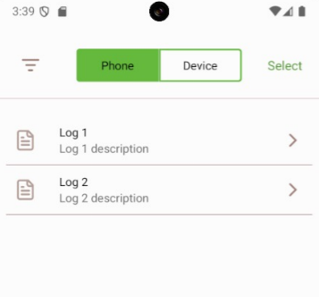
S.A.G.E
Data Management
Cleaned readings are stored a CSV inside a 768 kB SPIFFS partition—about 17 000 rows, or 354 days of data at 30-minute intervals, before the oldest lines recycle.
The mobile app lists logs stored on the phone and detects connected devices; CSV files pulled from the ESP32 are sent to the Mobile Application to be inserted into a local database.
We can view both the Phone's CSV files & the ESP32 local files. This aids to manage multiple ESP32 devices.

Slide 12
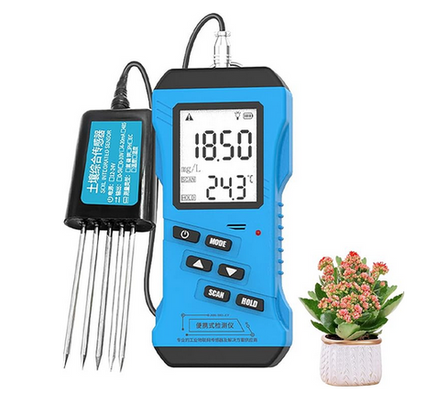
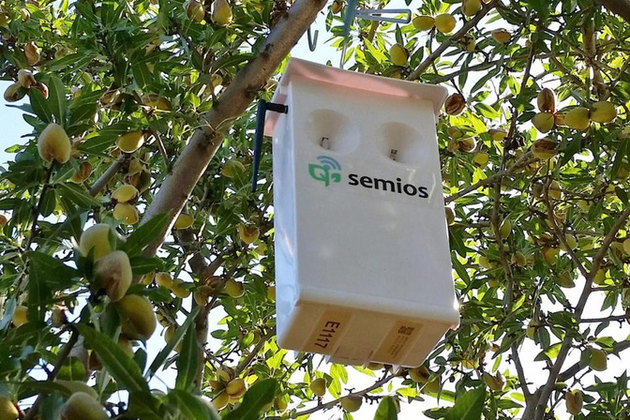
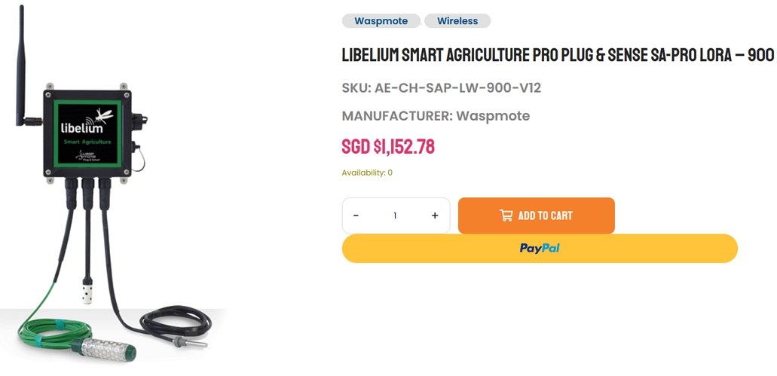
S.A.G.E
Accessible & Sustainable Solution
Prototype hardware cost ≈ $80—Below commercial alternatives.
Power Efficient: Interrupts & Tasks to reduce power consumption.
Modularity: designed to have new sensors added depending on client's needs.
Quick set up just plug, power and connect in just a few minutes. Moving precision agriculture within reach of smallholders and community gardens.
$243
Annual Subscription: US$180 to US$260 an acre.
USD: ~$881

Slide 13
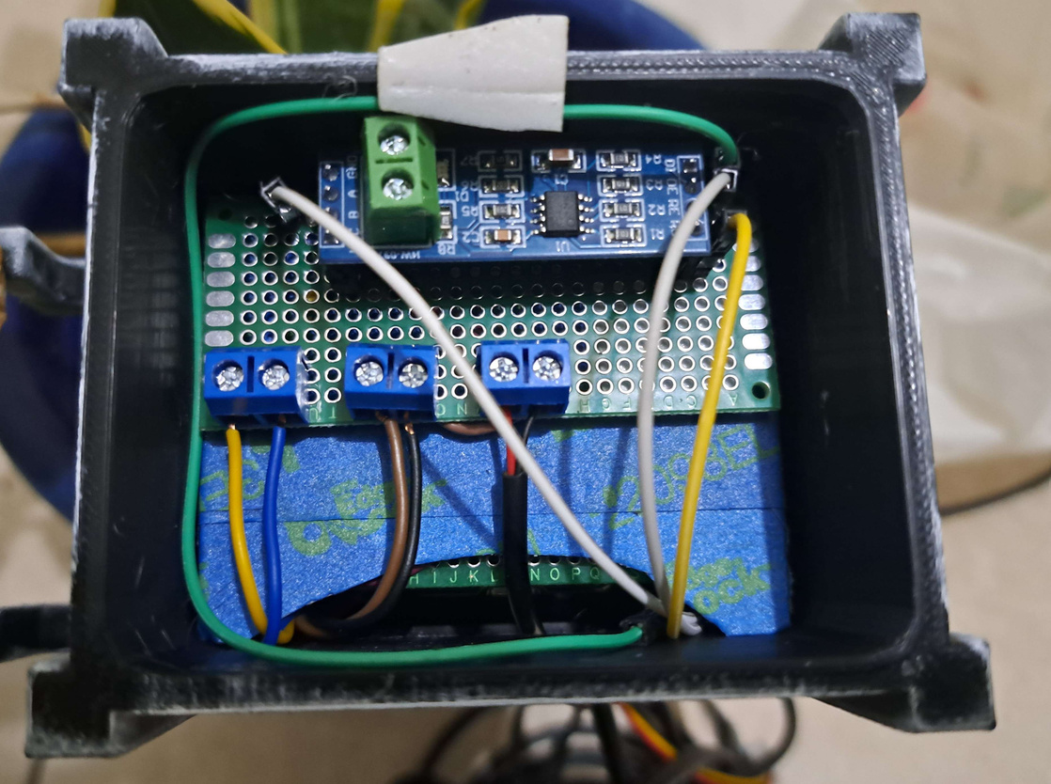
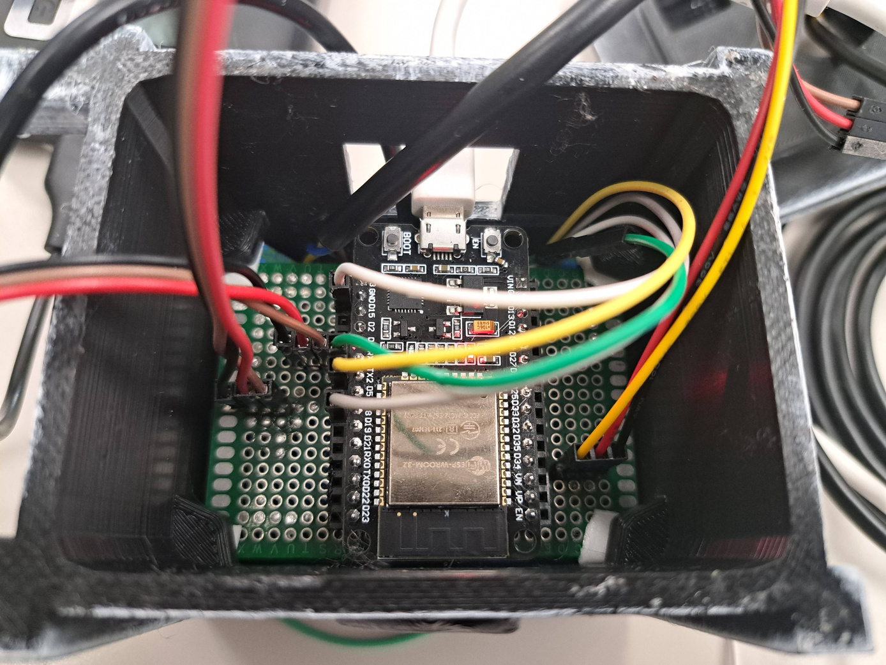
S.A.G.E
Challenges
01
Parallelism & Concurrency: We used FreeRTOS to manage parallelism for both the Sensor Module and Internal Tool, This required intensive resource management to prevent starvation.
02
Compatibility: ESP-IDF lacked compatibility and extensive documentation for certain key features which forced us to create and migrate them into the Mobile App.
Modularity: The code needed to facilitate adding new sensors, this also meant the hardware needed be designed for easy replacement and adding of sensors.
03
Development: Testing builds on IOS Devices could not be done since development builds required an Mac. This also prevented some members from working on their own.
04

Slide 14
S.A.G.E
Conclusion
S.A.G.E. now turns a handful of low-cost instruments and a pocket-sized ESP32 into soil intelligence that farmers can consult in real time, right on their phones.

Slide 15
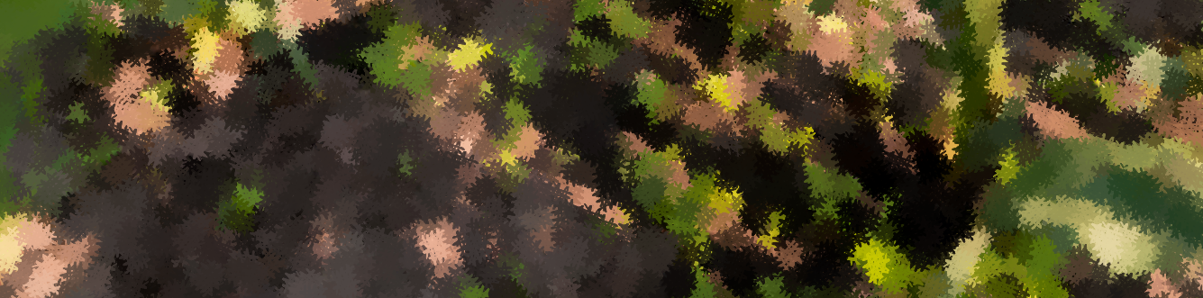
S.A.G.E
Demo video
Mobile application
https://youtu.be/sjRJSPyO1XE
Internal tool
https://youtu.be/7evgZUxxD_E

Slide 16
S.A.G.E
Thank You

